Slide 1
Predicting Investment Success: Unlocking Startup Potential
Zahir Razzaz
Capstone Project _ Sprint 3

Slide 2
Overview and Problem Statement
The Startup Conundrum: Navigating Investments with Data
Introduction to Startups:
- Innovative companies, in pursuit of rapid growth through unique products or services.
- The startup world is flourishing. Daily, hundreds of startups launch, with venture capital investments topping $100B annually in the US*.
The Allure of Startups:
- They represent the forefront of innovation, often disrupting traditional sectors and tapping into uncharted markets.
However, only about 10% of startups last long-term.
The Investment Dilemma:
1. Highlight the challenge: "Despite their potential, a significant portion of startups don't achieve long-term success. This unpredictability poses challenges for investors.
2. Emphasize the opportunity: "With abundant historical data on startups, Can we discern patterns of success and failure, guiding investment decisions?
2/15

Slide 3
Data Science Vision & Approach
Understanding Startups: A Data-Driven Approach
  Diverse Startups: Our dataset provides a snapshot of over 49,000 startups, each with its unique journey, spanning different markets and countries.
  Success & Challenges: While some startups have achieved the coveted 'acquired' status, many have 'closed', offering valuable lessons.
Pattern Detection: Beyond the sheer numbers, we seek patterns. Which sectors thrive? What funding levels often lead to success?
Predictive Power: Armed with algorithms, our mission is to forecast a startup's potential, turning raw data into actionable insights.
Decision Enabler: In the complex world of investments, our goal is to be the beacon, guiding decisions not just by intuition, but with data-driven confidence.
Complexity: The startup ecosystem is intricate. Multiple factors play a role in success, from funding to market choice.
Why Data Science?
Informed Decisions: As data scientists, we bridge the gap between uncertainty and informed decision-making. Our analyses provide clarity in the fog of startup investments.
2/11

Slide 4
Amplifying Startup Success: The Data Scientist's Influence
  Our dataset isn’t just numbers. It's 49,000+ stories, each startup with its unique trajectory. From the amount of funding they received to the markets they ventured into, we have a microscopic view.
- From funding amounts to operational sectors, the dataset offers granular insights that can shape investment strategies.
Predictive Analytics: Beyond just understanding past trends, our goal is to forecast. Which startups have the potential to soar? Which might face challenges?
Risk Mitigation: By identifying success patterns, we can guide investments, potentially reducing risks and increasing ROI.
Strategic Guidance: Our analyses can advise startups and investors on pivotal decisions: Which sector to venture into? How much funding to seek?
Potential Impact:
Informed Investments
Startup Success Boost
Economic Growth
2/11

Slide 5
Findings from Extended EDA
Startup Status Distribution:
  The majority of startups in the dataset have been acquired, with a smaller fraction being closed.
Total Funding based on Startup Status:
  Both acquired and closed startups have a wide range of funding amounts.
  The median funding is slightly higher for startups that were acquired. However, there are many outliers, especially in the acquired category, indicating startups that received exceptionally high funding.
Regional Distribution:
  California (CA) overwhelmingly dominates the startup landscape, with the highest number of startups.
  This is followed by Massachusetts (MA), New York (NY), and Texas (TX), among others.
Age at First Milestone:
On average, startups that were acquired reached their first milestone slightly earlier compared to those that closed.
2/11

Slide 6
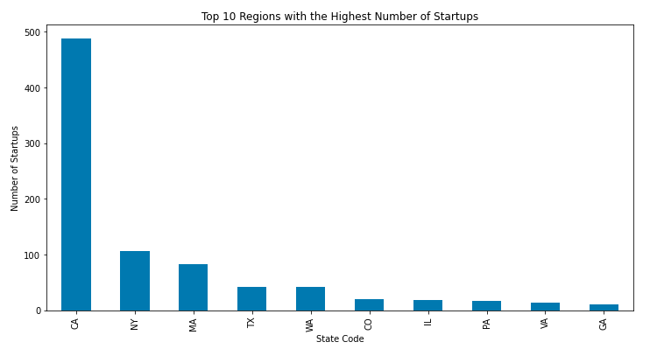
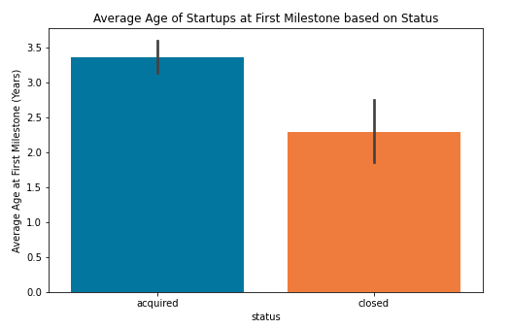
Distribution of startups From EDA
Type | Number
Software | 153
Web | 144
Mobile | 79
Enterprise | 73
advertising | 62
Games_Video | 52
Semiconductor | 35
Network_hosting | 34
Biotech | 34
Hardware | 27
Regional Distribution
Age at First Milestone
EDA, the software and web categories dominate the dataset, indicating their prominence in the startup landscape.
2/11

Slide 7
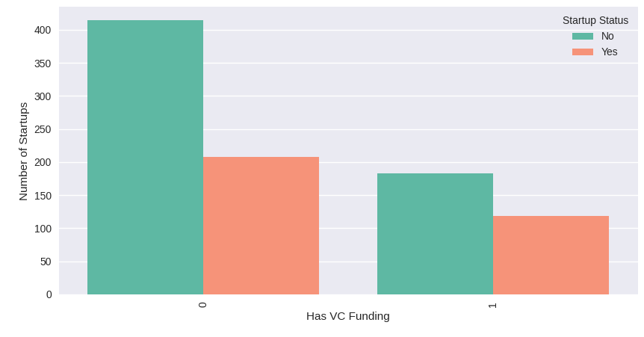
Findings from Extended EDA
2/11

Slide 8
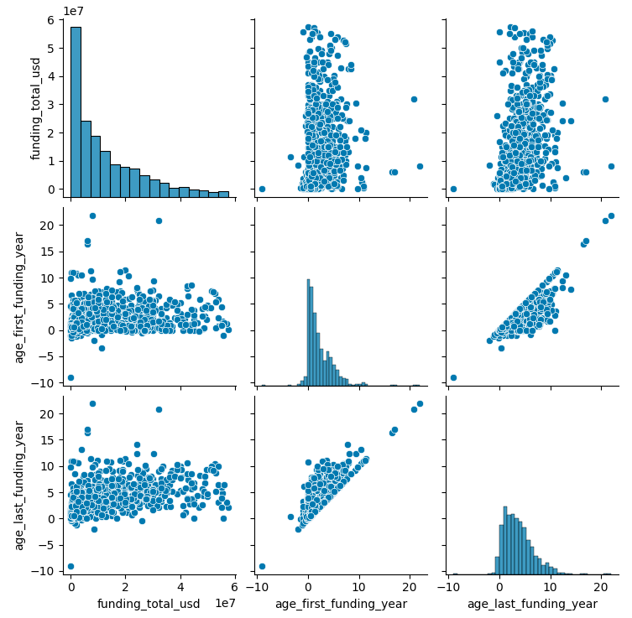
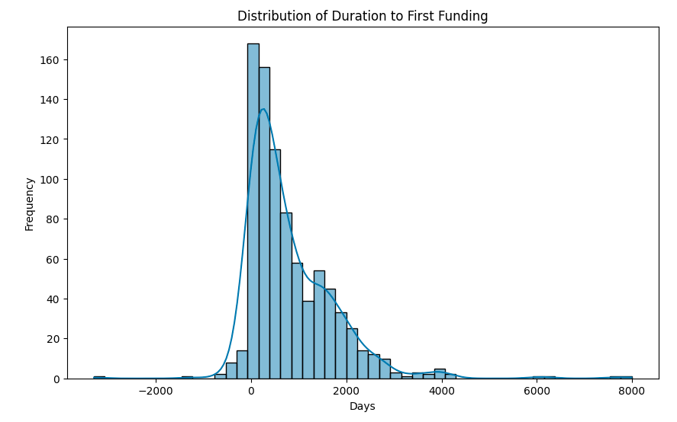
Distribution of startups From EDA
2/11

Slide 9
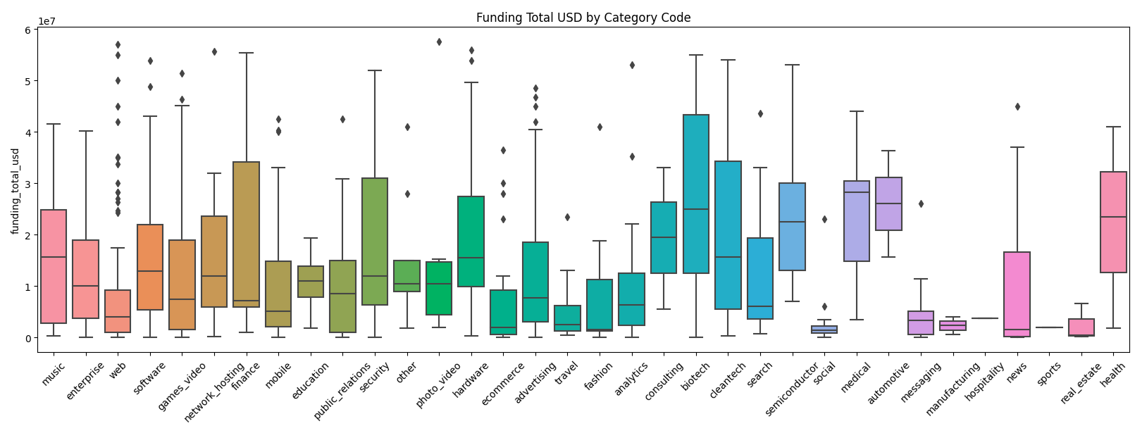
Findings from Extended EDA
2/11

Slide 10
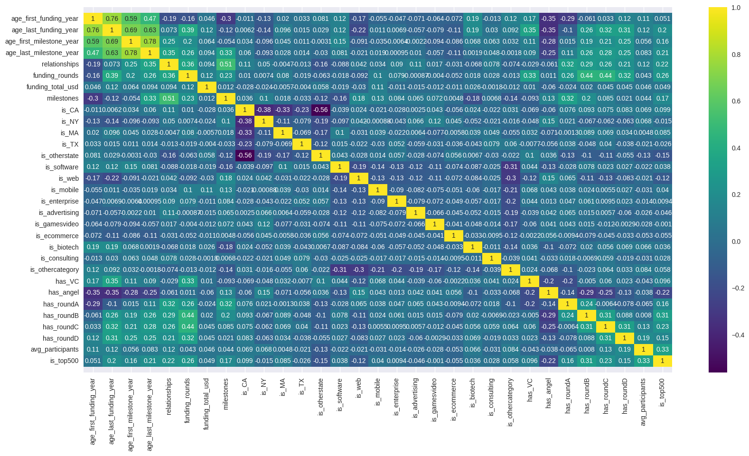
Correlation Matrix
2/11
9/11

Slide 11
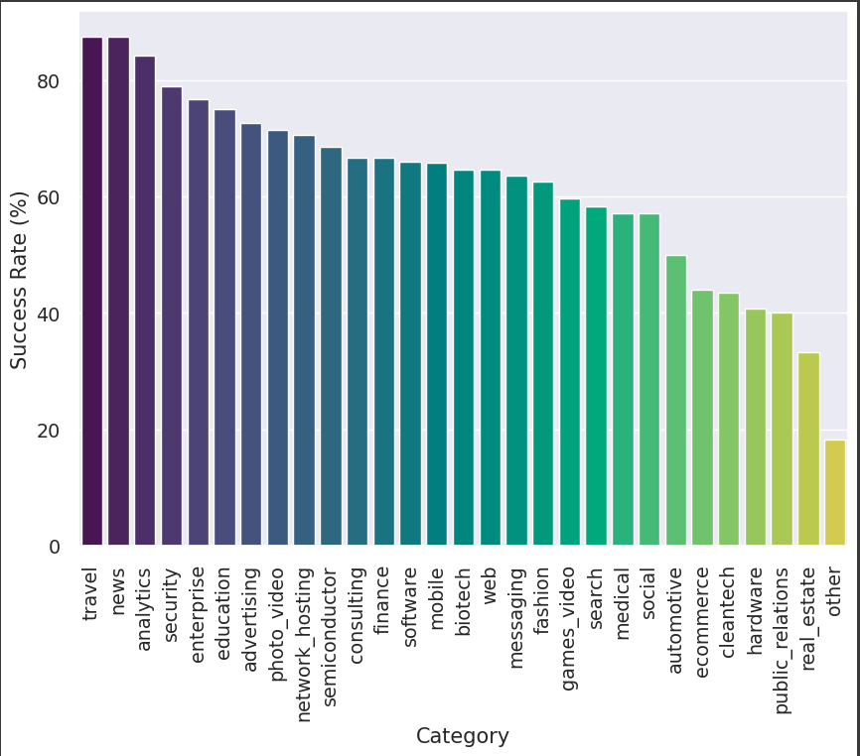
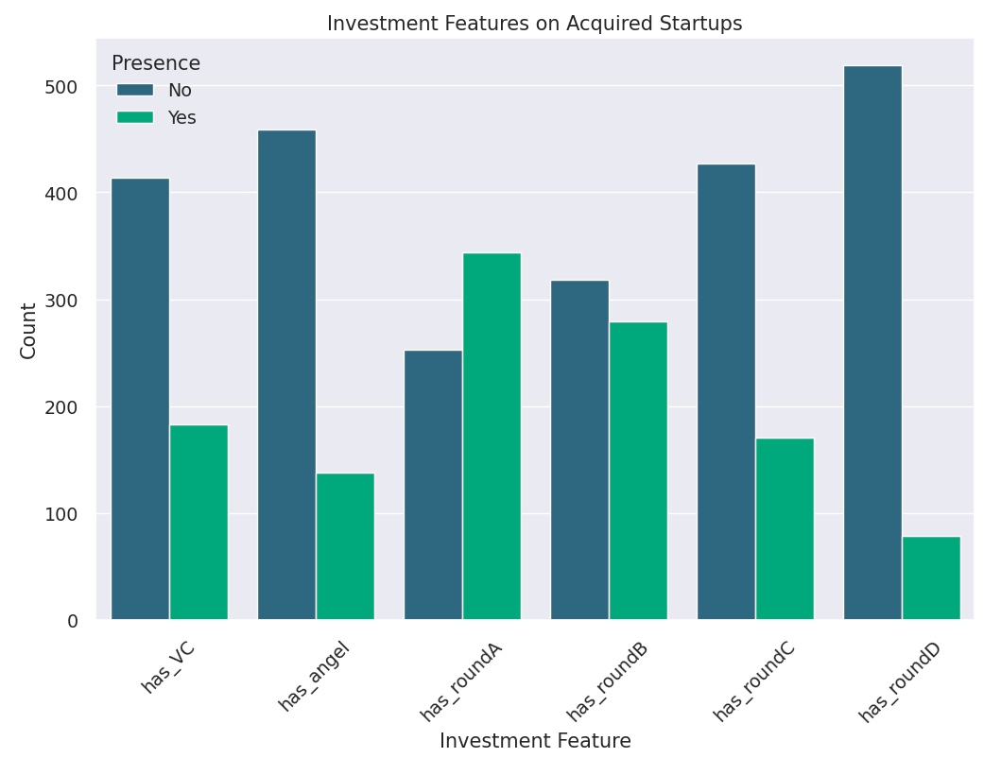
Correlation Matrix
2/11
9/11

Slide 12
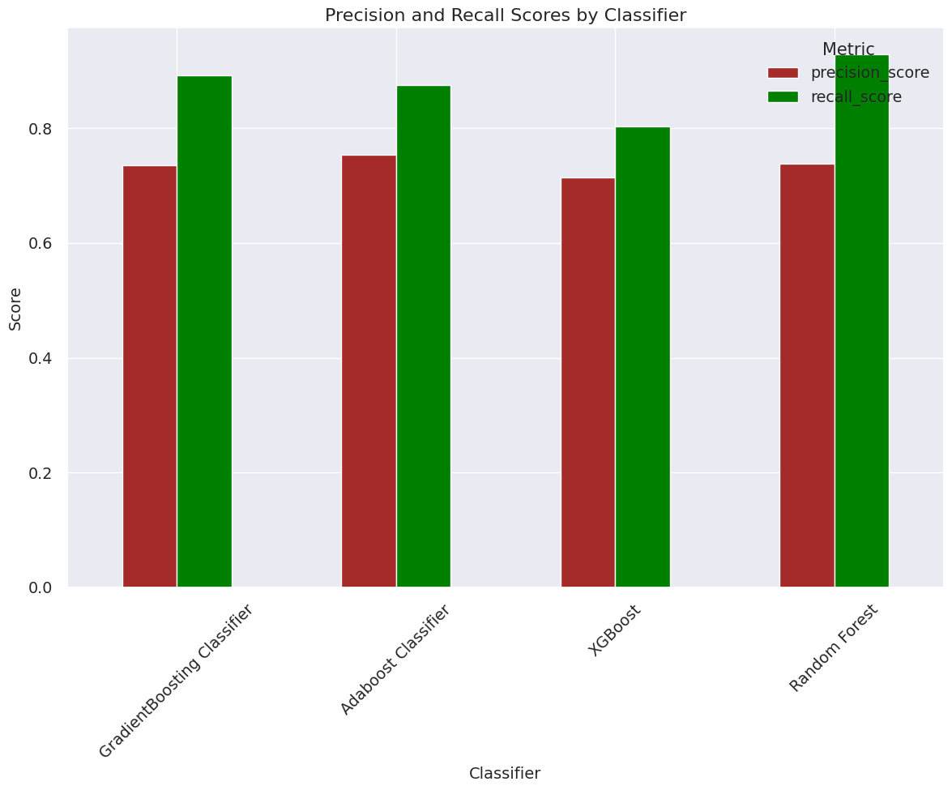
Correlation Matrix
2/11
9/11

Slide 13
Correlation Matrix
Key Findings
* Model Performance: All models demonstrated commendable performance, with Precision-Recall AUC scores indicating their effectiveness in handling the binary classification task. The scores suggest that each model has strengths that could be leveraged depending on specific use-case requirements.
* Model Comparison: The horizontal bar chart provided a visual summary of model comparisons, revealing slight variations in performance that might influence model selection for particular applications.
Conclusion
The evaluation underscores the importance of considering Precision-Recall AUC scores when selecting models for tasks with imbalanced datasets. While all tested models showed potential, the choice of model might depend on specific project goals, including the relative importance of precision versus recall in the given context. Further research and testing, possibly including a broader set of models and tuning parameters, could yield even more insights into model selection and performance optimization.
# Limitations and Directions for Future Work:
This project acknowledges certain limitations, including potential biases within the dataset and the constrained range of features considered for success prediction. Future endeavors may extend this research by incorporating more diverse datasets, exploring additional predictive features, and validating the model's efficacy with actual startup outcomes.
2/11
9/11

Slide 14
Correlation Matrix
Key Findings
* Model Performance: All models demonstrated commendable performance, with Precision-Recall AUC scores indicating their effectiveness in handling the binary classification task. The scores suggest that each model has strengths that could be leveraged depending on specific use-case requirements.
* Model Comparison: The horizontal bar chart provided a visual summary of model comparisons, revealing slight variations in performance that might influence model selection for particular applications.
Conclusion
The evaluation underscores the importance of considering Precision-Recall AUC scores when selecting models for tasks with imbalanced datasets. While all tested models showed potential, the choice of model might depend on specific project goals, including the relative importance of precision versus recall in the given context. Further research and testing, possibly including a broader set of models and tuning parameters, could yield even more insights into model selection and performance optimization.
# Limitations
This project acknowledges certain limitations:
- Current biases in data
- Limited success predictors
# Directions for Future Work:
- Broader datasets
- More features
- Real-world validation
2/11
9/11

Slide 15
THANK YOU!
FOR YOUR ATTENTION
2/11

Slide 16
##Note
For this Capstone project, I am focusing on a data-driven exploration of the factors contributing to the success of billion-dollar startups, commonly termed "unicorns." While gathering data, I encountered several datasets and am in the process of integrating these into a primary dataset for comprehensive analysis. This analysis covers over 50 to 200 billion-dollar startups, contrasting them with thousands of unsuccessful ones. The study includes:
Founder Experience: It shows that successful billion-dollar company founders typically have about 11 years of executive or entrepreneurial experience, often outside their startup's industry.
Debunking Myths: This aspect challenges common myths about startups, like needing a unique idea, a technical co-founder, a first-mover advantage, or a specific type of education.
Idea Generation and Market Understanding: Successful startups often arise from identifying market needs and aligning these with the founder's passion. Flexibility and adaptability in pivoting from initial ideas are highlighted as key.
Market Differentiation: The research indicates that successful startups either find unique positions within established markets or create entirely new markets.
Venture Capital and Funding: Although most unicorns are backed by venture capital, sheer investment size isn't a success guarantee. Predictors of unicorn success include ambitious visions, market savvy, and prior startup experience. Factors like the founder's age, educational background, and the startup's geographical location also play significant roles.
However, unfortunately, while searching for data, I encountered numerous datasets. I am currently working on integrating these into the main dataset for this project.

Slide 17
Overall Success Factors:
The true predictors of startup success include
Big dreams, A solid understanding of the market, Previous startup experience​​, Founder's age, Educational background, and the startup's geographic location (country or region) can also play crucial roles.
Correlation is not causation
The same name of the founder would not be a factor in a startup's success.
Multiple comparison problem.

Slide 19
...and our sets of editable icons
You can resize these icons without losing quality.
You can change the stroke and fill color; just select the icon and click on the paint bucket/pen.
In Google Slides, you can also use Flaticon’s extension, allowing you to customize and add even more icons.

Slide 20
Educational Icons
Medical Icons

Slide 21
Business Icons
Teamwork Icons

Slide 22
Help & Support Icons
Avatar Icons

Slide 23
Creative Process Icons
Performing Arts Icons

Slide 24
Nature Icons

Slide 25
SEO & Marketing Icons

